Slide 1
CSCI3150 Introduction to Operating Systems
Lecture 8: Common
Concurrency Problems

Slide 2
Non-Deadlock Bugs
Makes up a majority of concurrency bugs.
Two major types of non-deadlock bugs:
Atomicity violation
Order violation

Slide 3
Atomicity-Violation Bugs
The desired serializability among multiple memory accesses is violated.
Simple Example found in MySQL:
Two different threads access the field proc_info in the struct thd.
1 Thread1::
2 if(thd->proc_info){
3 …
4 fputs(thd->proc_info , …);
5 …
6 }
7
8 Thread2::
9 thd->proc_info = NULL;

Slide 4
Atomicity-Violation Bugs (Cont.)
Solution: Simply add locks around the shared-variable references.
pthread_mutex_t lock = PTHREAD_MUTEX_INITIALIZER;
Thread1::
pthread_mutex_lock(&lock);
if(thd->proc_info){
…
fputs(thd->proc_info , …);
…
}
pthread_mutex_unlock(&lock);
Thread2::
pthread_mutex_lock(&lock);
thd->proc_info = NULL;
pthread_mutex_unlock(&lock);

Slide 5
Order-Violation Bugs
The desired order between two memory accesses is flipped.
i.e., A should always be executed before B, but the order is not enforced during execution.
Example:
The code in Thread2 seems to assume that the variable mThread has already been initialized (and is not NULL).
Thread1::
void init(){
mThread = PR_CreateThread(mMain, …);
}
Thread2::
void mMain(…){
mState = mThread->State
}

Slide 6
Order-Violation Bugs (Cont.)
Solution: Enforce ordering using condition variables
pthread_mutex_t mtLock = PTHREAD_MUTEX_INITIALIZER;
pthread_cond_t mtCond = PTHREAD_COND_INITIALIZER;
int mtInit = 0;
Thread 1::
void init(){
…
mThread = PR_CreateThread(mMain,…);
// signal that the thread has been created.
pthread_mutex_lock(&mtLock);
mtInit = 1;
pthread_cond_signal(&mtCond);
pthread_mutex_unlock(&mtLock);
…
}

Slide 7
Order-Violation Bugs (Cont.)
Thread2::
void mMain(…){
// wait for the thread to be initialized …
pthread_mutex_lock(&mtLock);
while(mtInit == 0)
pthread_cond_wait(&mtCond, &mtLock);
pthread_mutex_unlock(&mtLock);
mState = mThread->State;
…
}

Slide 8
Deadlock Bugs
Thread 1: lock(L1); lock(L2); | Thread 2: lock(L2); lock(L1);
The presence of a cycle
Thread1 is holding a lock L1 and waiting for another one, L2.
Thread2 that holds lock L2 is waiting for L1 to be released.
Thread 1
Holds
Lock L1
Wanted by
Wanted by
Lock L2
Thread 2
Holds

Slide 9
Why Do Deadlocks Occur?
Reason 1:
In large code bases, complex dependencies arise between components.
Reason 2:
Due to the nature of encapsulation
Hide details of implementations and make software easier to build in a modular way.
Such modularity does not mesh well with locking.

Slide 10
Why Do Deadlocks Occur? (Cont.)
Example: Java Vector class and the method AddAll()
Locks for both the vectors being added to (v1) and the parameter (v2) need to be acquired.
vector v1,v2;
// thread 1
v1.AddAll(v2);
// thread 2
v2.AddAll (v1) ;

Slide 11
Conditions for Deadlock
Four conditions need to hold for a deadlock to occur.
If any of these four conditions are not met, deadlock cannot occur.
Condition | Description
Mutual Exclusion | Threads claim exclusive control of resources that they require.
Hold-and-wait | Threads hold resources allocated to them while waiting for additional resources
No preemption | Resources cannot be forcibly removed from threads that are holding them.
Circular wait | There exists a circular chain of threads such that each thread holds one more resources that are being requested by the next thread in the chain

Slide 12
Prevention – Circular Wait
Provide a total ordering on lock acquisition
This approach requires careful design of global locking strategies.
Example:
There are two locks in the system (L1 and L2)
We can prevent deadlock by always acquiring L1 before L2.

Slide 13
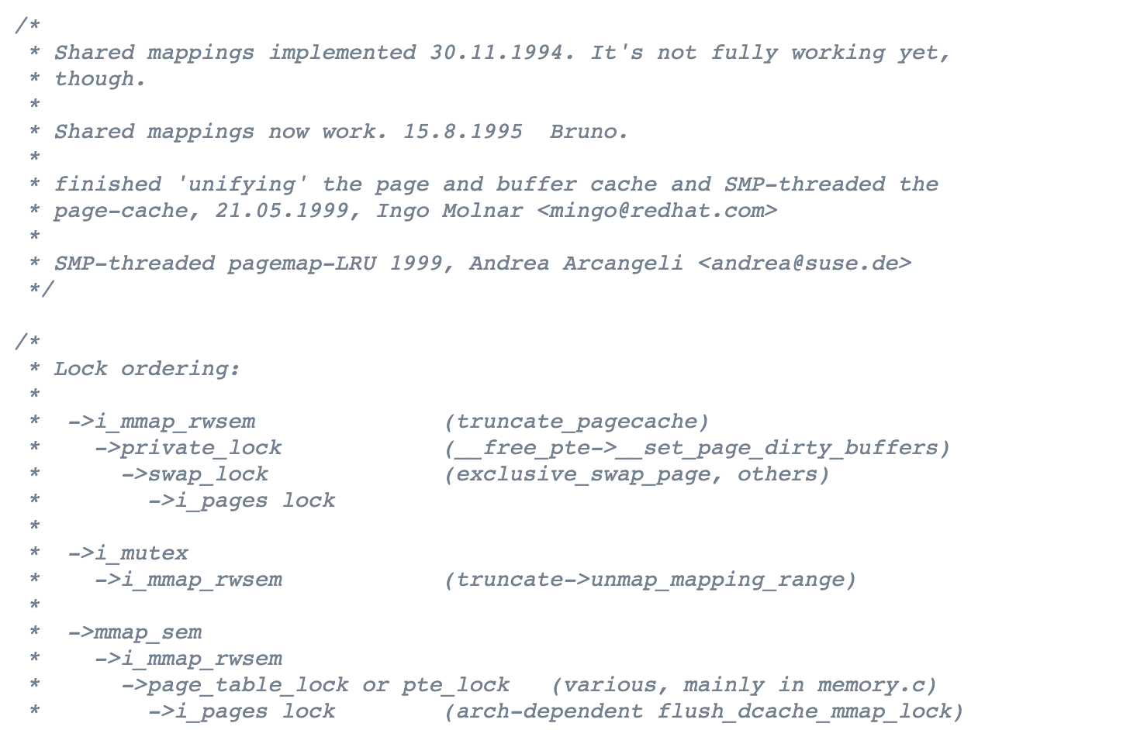
Avoiding Circular Wait
https://elixir.bootlin.com/linux/latest/source/mm/filemap.c

Slide 14
Prevention – Hold-and-wait
Acquire all locks at once, atomically.
This code guarantees that no untimely thread switch can occur in the midst of lock acquisition.
Problem:
Require us to know when calling a routine exactly which locks must be held and to acquire them ahead of time.
Decrease concurrency
1 lock(prevention);
2 lock(L1);
3 lock(L2);
4 …
5 unlock(prevention);

Slide 15
Prevention – No Preemption
Multiple lock acquisition often gets us into trouble because when waiting for one lock we are holding another.
trylock()
Used to build a deadlock-free, ordering-robust lock acquisition protocol.
Grab the lock (if it is available).
Or, return -1: you should try again later.
top:
lock(L1);
if( tryLock(L2) == -1 ){
unlock(L1);
goto top;
}

Slide 16
Prevention – No Preemption (Cont.)
livelock
Both systems are running through the code sequence over and over again.
Progress is not being made.
Solution:
Add a random delay before looping back and trying the entire thing over again.

Slide 17
Prevention – Mutual Exclusion
wait-free
Using powerful hardware instructions (CPU).
You can build data structures in a manner that does not require explicit locking.
int CompareAndSwap(int *address, int expected, int new){
if(*address == expected){
*address = new;
return 1; // success
}
return 0;
}

Slide 18
Prevention – Mutual Exclusion (Cont.)
We now want to atomically increment a value by a certain amount:
Repeatedly tries to update the value to the new amount and uses the compare-and-swap to do so.
No lock is acquired
No deadlock can arise
livelock is still a possibility.
void AtomicIncrement(int *value, int amount){
do{
int old = *value;
}while( CompareAndSwap(value, old, old+amount)==0);
}

Slide 19
Prevention – Mutual Exclusion (Cont.)
Another example:
Surrounding this code with a lock acquire and release.
wait-free manner using the compare-and-swap instruction
void insert(int value){
node_t * n = malloc(sizeof(node_t));
assert( n != NULL );
n->value = value ;
lock(listlock); // begin critical section
n->next = head;
head = n;
unlock(listlock) ; //end critical section
}
void insert(int value) {
node_t *n = malloc(sizeof(node_t));
assert(n != NULL);
n->value = value;
do {
n->next = head;
} while (CompareAndSwap(&head, n->next, n));
}

Slide 20
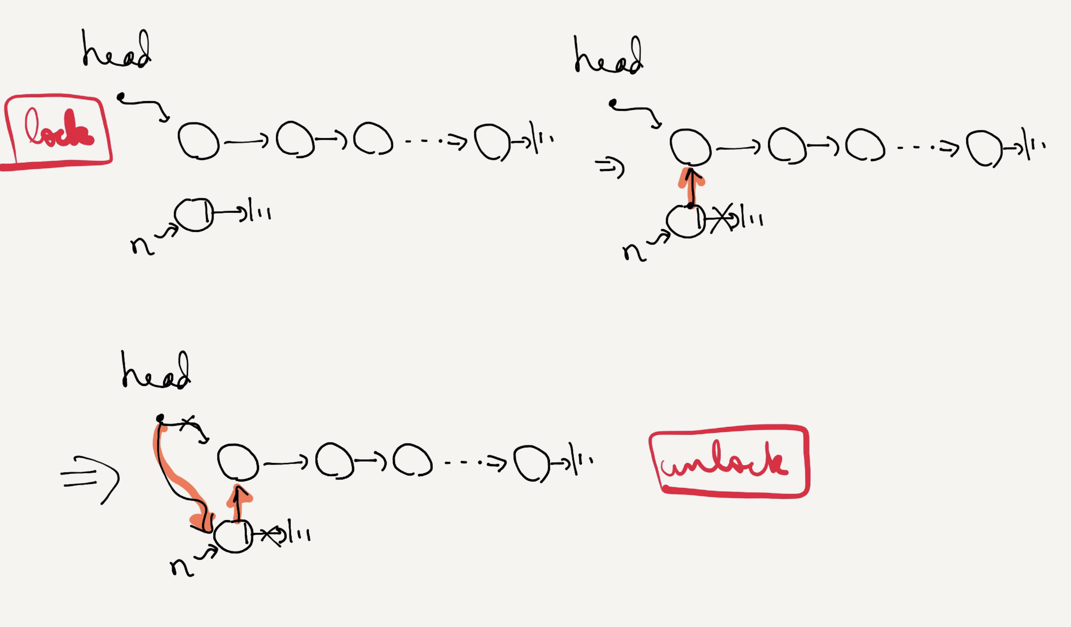
Insert with lock

Slide 21
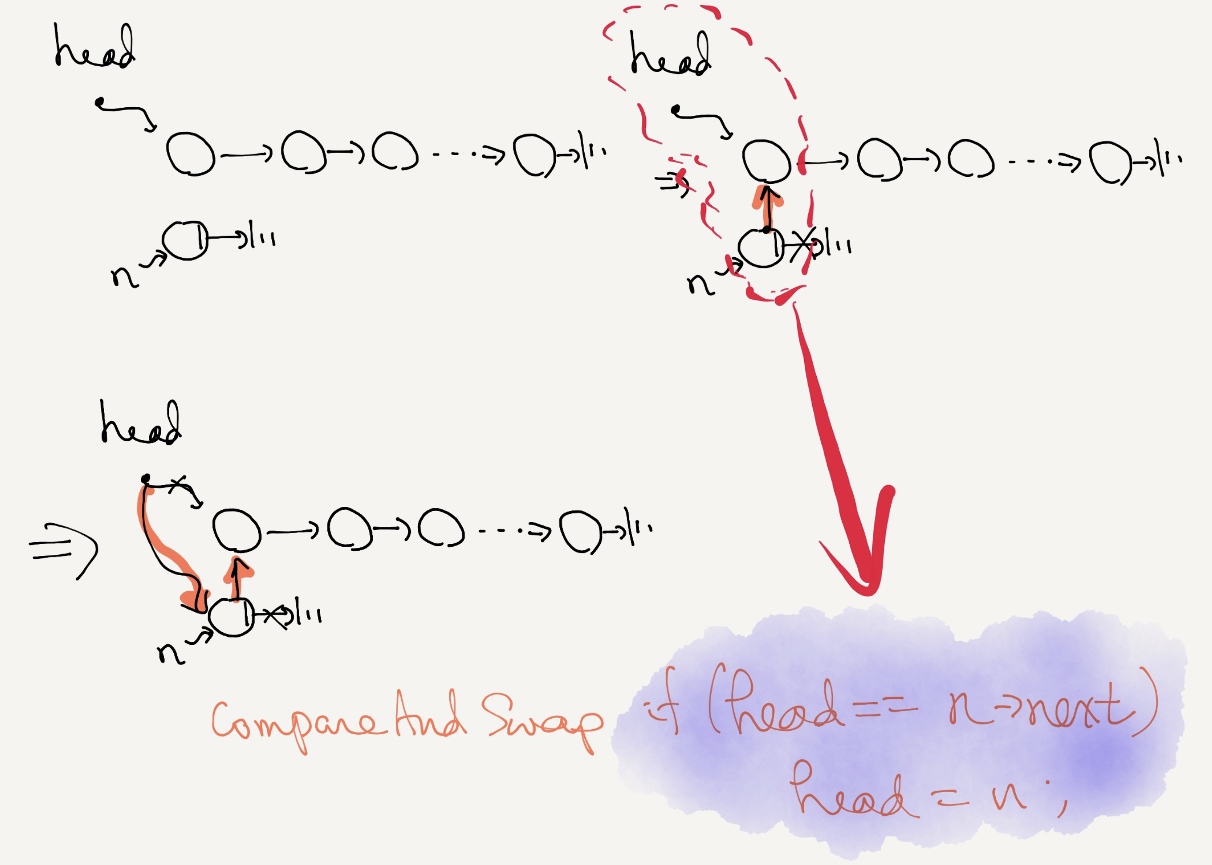
Lock-free insert

Slide 22
Deadlock Avoidance via Scheduling
Deadlock Avoidance
Get the information about the locks various threads might grab during their execution.
schedule the threads in a way to guarantee no deadlock can occur.
In some scenarios, deadlock avoidance is preferable.
Problem: Global knowledge is required.
Not commonly used. Refer to textbook for more details

Slide 23
Detect and Recover
Allow deadlocks to occasionally occur and then take some action.
Example: if an OS froze, you would reboot it.
Many database systems employ deadlock detection and recovery technique.
A deadlock detector runs periodically.
Building a resource graph and checking it for cycles.
In deadlock, the system needs to be restarted.

Slide 24
Summary
Non-deadlocked bugs
Atomicity violation
Ordering violation
Deadlock
Enforcing the lock order
Lockless mechanism

